Slide 1
Hand tool design
Jenna Kleinow

Slide 2
Overview
History and importance of hand tool design
Considerations of hand tool design
Literature Review of hand tool design in laparoscopic surgery
Discussion

Slide 3
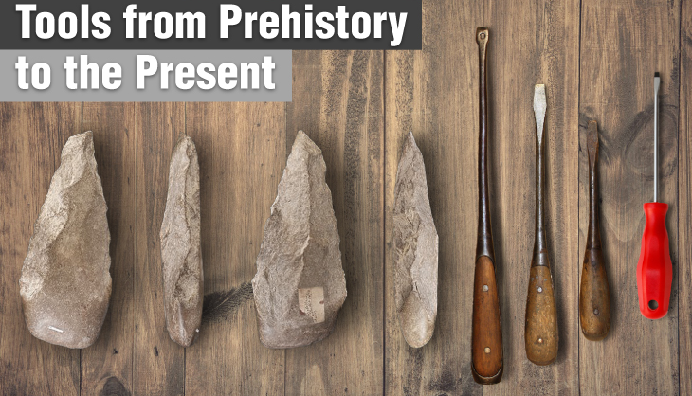
Hand tools: history
Hand tools are thought to date back to the Stone Age ~2.5 million years ago
Early tools allowed humans to obtain food and protect themselves
Some cultures economically and politically depended on the sophistication of their hand tools
Today, hand tools tend to be thought of as irrelevant within our complex industrial operations
https://ronixtools.com/
(Chaffin et al., Occupational Biomechanics 2006)

Slide 4
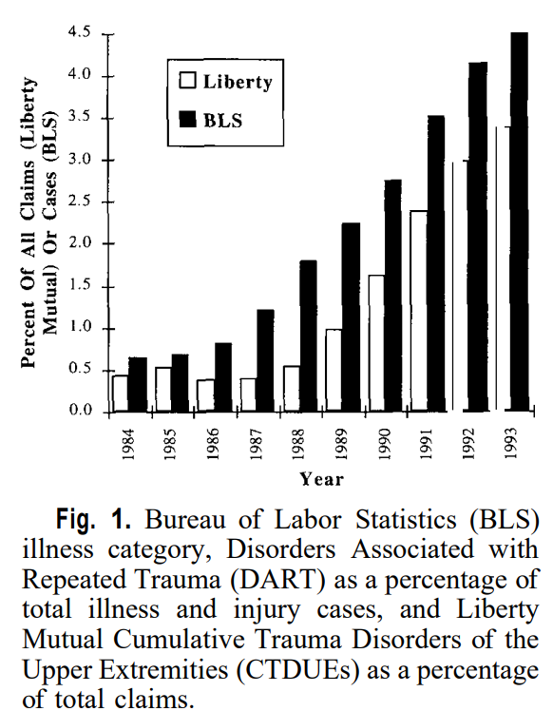
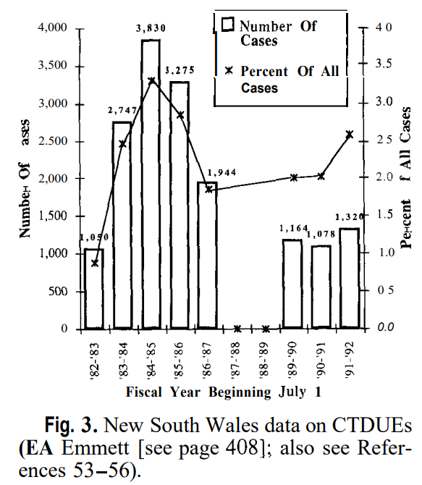
Hand tools: History
Bureau of labor statistics (BLS) for cumulative trauma disorder of the upper extremity (CTDUE) represent 3-5% (1996)
Why the steady increase?
What is different in New South Wales, Australia?
2020 numbers from the BLS show that upper extremity injuries involving days away from work make up ~2%
CTDUEs may not be fully reported; slower and more subtle
These injuries are more unrecognized because people assume they will get better
(Brogmus et al., 1996)
(Brogmus et al., 1996)
www.bls.gov/web/osh/cd_eh1.htm

Slide 5
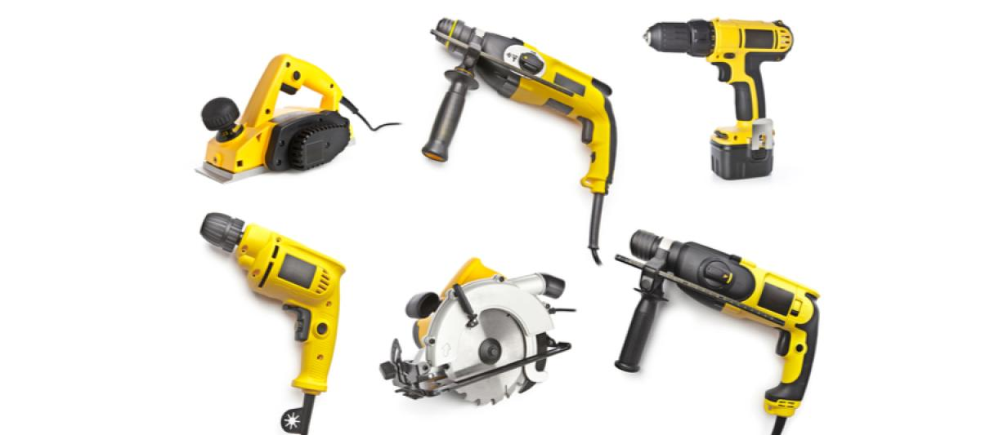
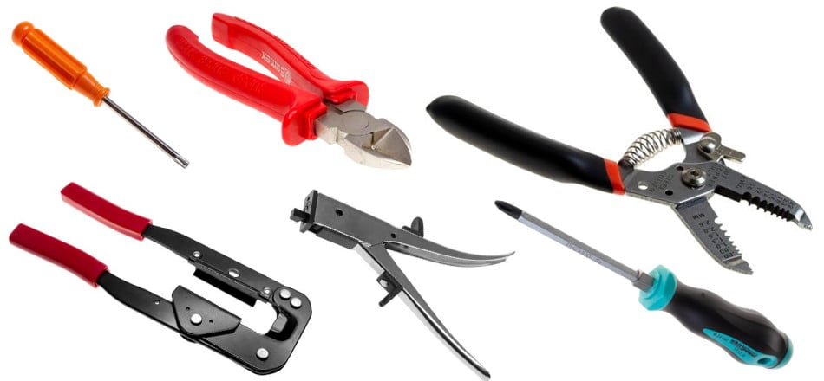
Hand tools: importance
Why do we use hand tools?
Decrease effort
Increase speed
Increase strength
Increase precision

Slide 6
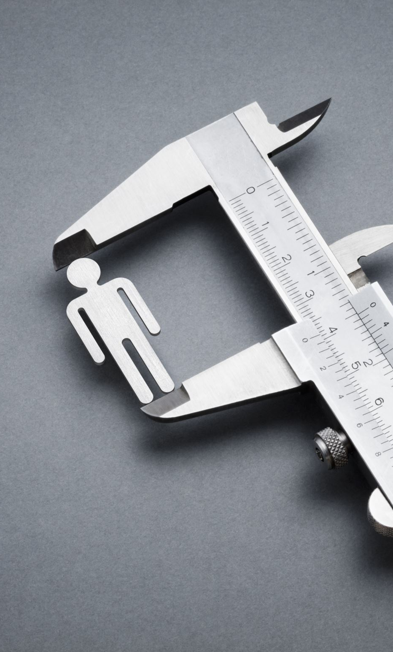
Hand tool design: considerations
Position
Grip
Shape

Slide 7
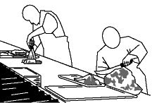
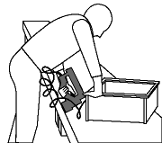
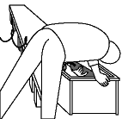
Position
People tend to adapt their hands to the tool
Lead to injuries: carpal tunnel, trigger finger, tennis elbow, etc.
Consider the work surface and how you may need to position yourself for a more neutral grip
Optimize for shoulder and wrist
Canadian Centre for Occupational Health and Safety

Slide 8
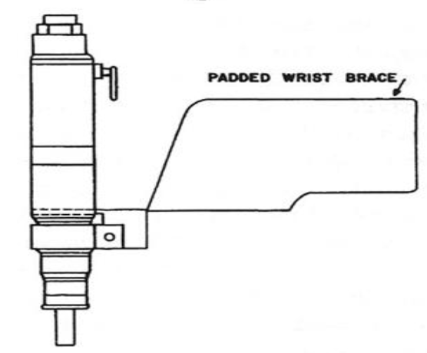
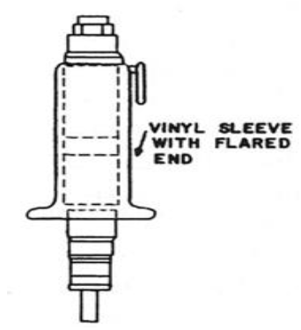
grip
Grip strength depends on grip span
Bigger hands gives an advantage
Women are more affected due to smaller hand size
Reducing load
Flared sleeve
Incorporate a padded wrist brace, if able
Both reduce force required of finger flexors
(Chaffin et al., Occupational Biomechanics 2006)

Slide 9
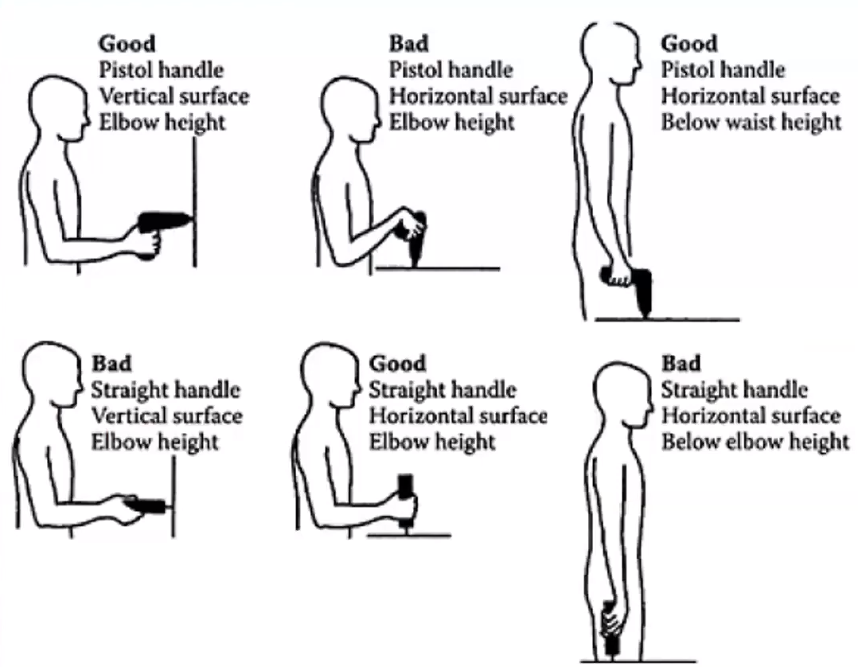
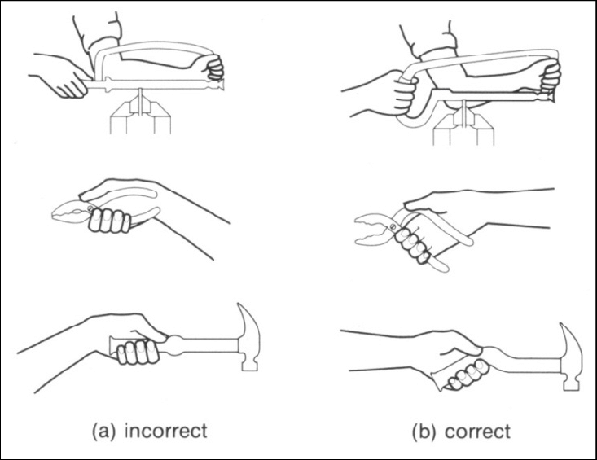
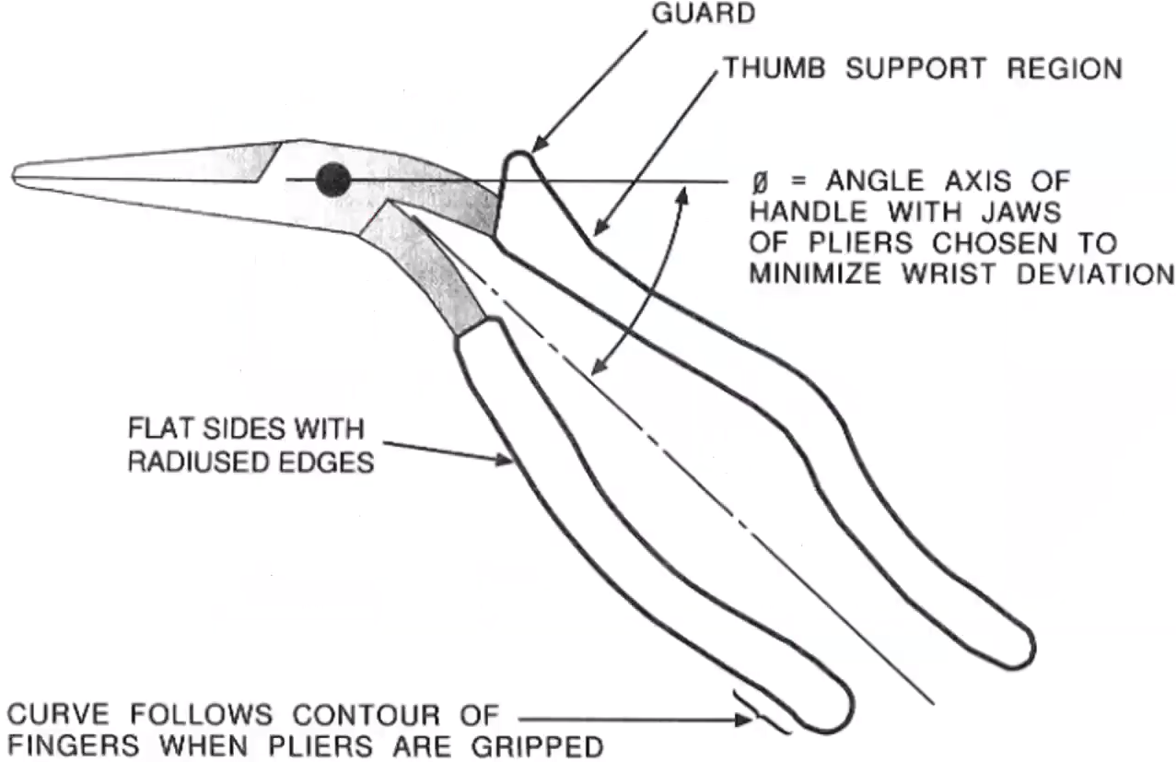
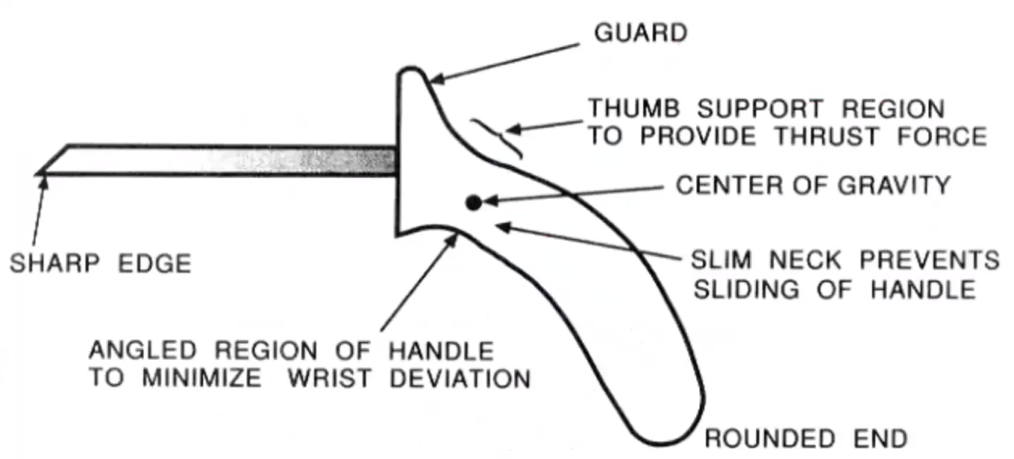
shape
Tools handles should be shaped in a way that assists your grip.
Compression of the extensor tendon if too tight.
If handles are longer and padded, then the forces will be better distributed. Be able to work longer without injury
Cylindrical/inline vs. pistol shape
Tichauer (1978): bent pliers
Lewis & Naryan 1993 found lower grip force in EMG
Think about handle radius and finger clearance
Will the user be wearing gloves?
(Kaljun & Dolsak, 2011)
(Armstrong, 1983)
(Tichauer, 1978)
(Lewis & Naryan, 1993)

Slide 10
Literature review
Ergonomic assessment of a new hand tool design for laparoscopic surgery based on surgeons’ muscular activity
A.G. González, J. Barrios-Muriel, F. Romero-Sánchez, D.R. Salgado, F.J. Alonso
Applied Ergonomics, 88 (2020) 103161

Slide 11
background
Laparoscopic surgery is used for non-invasive procedures, requiring precise tools to do so
Traditional instruments have led to physical complaints in upper limbs and back
Discomfort may impact the surgeon’s skills
Many designs are only offered in one size
A novel tool was designed in 2010 by some of the authors of this current work through the ERGOLAP Project
González et al. (2015) studied the influence of hand size in correlation with the optimal handle size of the instrument
135 surgeons instructed to perform tasks with the instrument in various diameters.
Matching hand size (XS, S, M, L) to the appropriate instrument diameter relates to optimal performance and lower fatigue.

Slide 12
background
Laparoscopic surgery is used for non-invasive procedures, requiring precise tools to do so
Traditional instruments have led to physical complaints in upper limbs and back
Discomfort may impact the surgeon’s skills
Many designs are only offered in one size
A novel tool was designed in 2010 by some of the authors of this current work through the ERGOLAP Project
González et al. (2015) studied the influence of hand size in correlation with the optimal handle size of the instrument
135 surgeons instructed to perform tasks with the instrument in various diameters.
Matching hand size (XS, S, M, L) to the appropriate instrument diameter relates to optimal performance and lower fatigue.
Purpose: research is needed to study the dynamic nature of muscle activity during laparoscopic surgery vs previous sEMG (static) signal

Slide 13
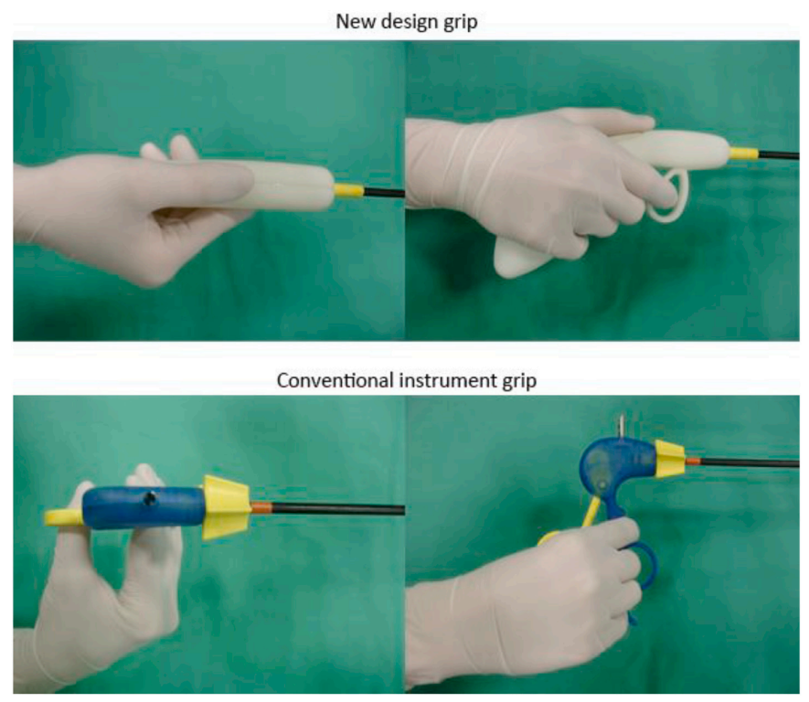
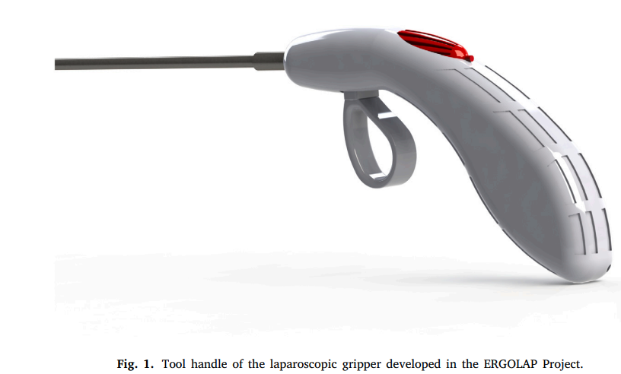
Materials and methods
(González, 2020)

Slide 14
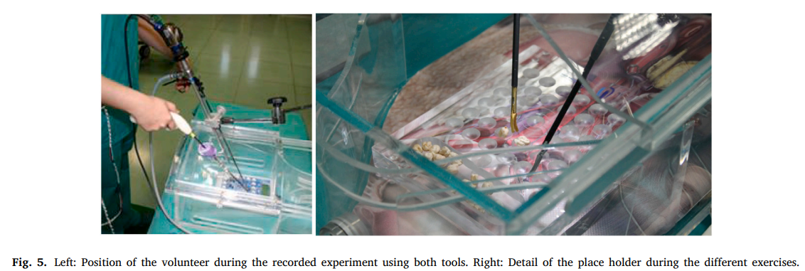
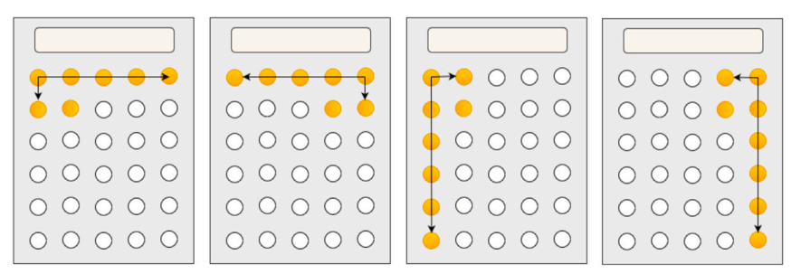
Materials and methods
10 subjects without surgical experience (ages 24-28; 2 female 8 male)
EMG signals were recorded on: brachioradialis, extensor digitorum, extensor carpi ulnaris, anterior deltoid, and upper trapezius. Raw signal was filtered using a Singular Spectrum Analysis (SSA) to acquire time-frequency analysis
4 sequences of hand-eye coordination tasks
Conventional design in one hand and novel design in the other. Swap the instruments between hands and repeat tasks.
Task 1
Task 2
Task 3
Task 4

Slide 15
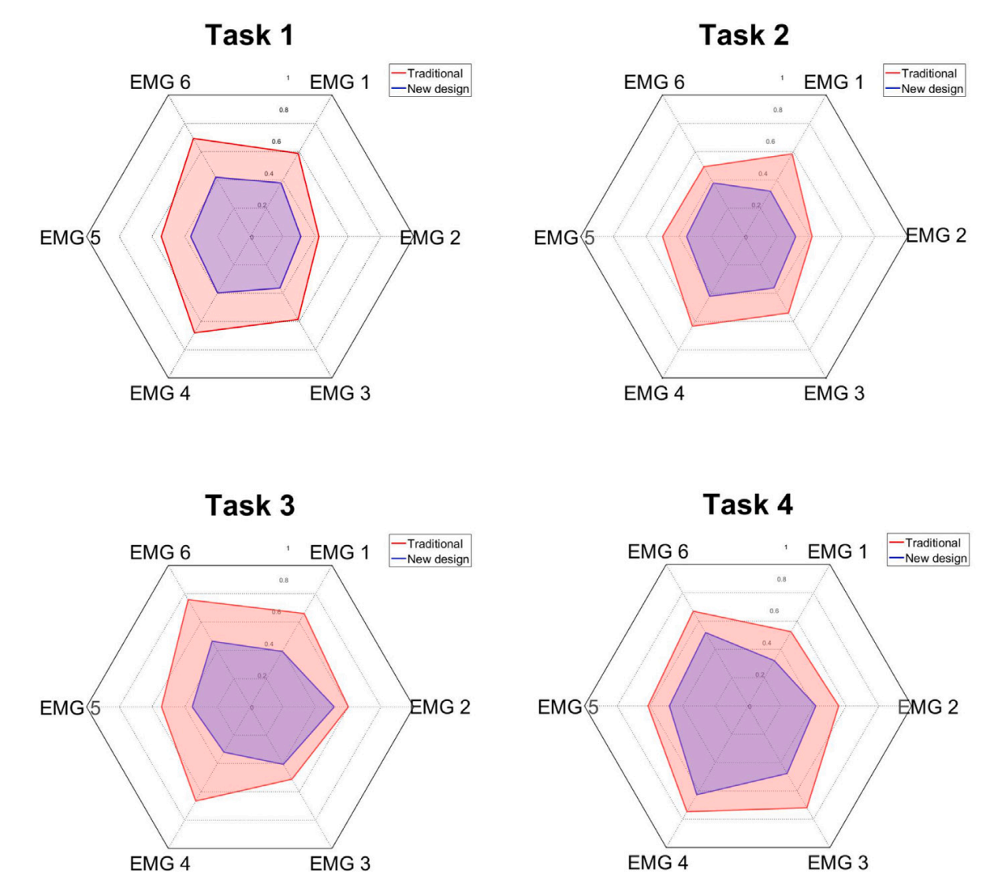
results
Novel design shows lower normalized averaged muscle activity level (NRMS) than the conventional design
EMG1: brachioradialis
EMG 2: extensor digitorum
EMG 3: extensor carpi ulnaris
EMG 4: deltoid
EMG 5: trapezius
EMG 6: flexor carpi radialis

Slide 16
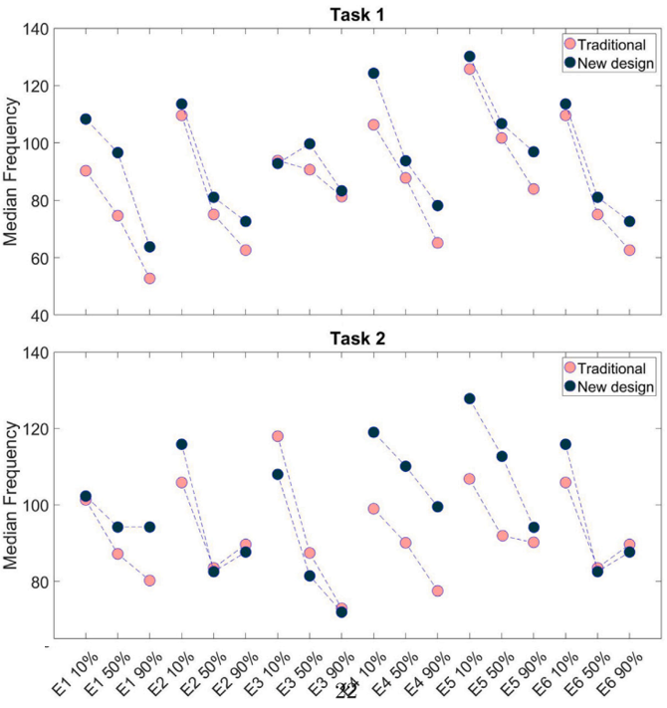
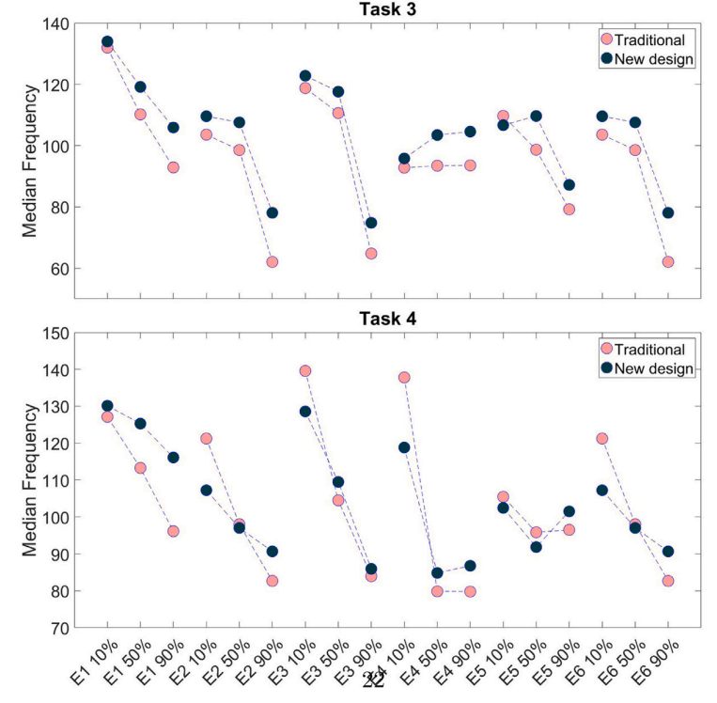
results
MDF (median frequency): estimate of muscle fatigue over time
As MDF decreases, higher muscle fatigue observed
Novel design delays muscle fatigue
E1: brachioradialis
E2: extensor digitorum
E3: extensor carpi ulnaris
E4: deltoid
E5: trapezius
E6: flexor carpi radialis

Slide 17
conclusion
Results show that the novel design outperforms the conventional design
Specifically, extensor carpi ulnaris and extensor digitorum show lower muscle activity with novel design

Slide 18
Limitations and further research
Subjects do not have surgical experience
Research may benefit by involving expert subjects
More specific and applicable tasks, such as suturing could be used
Sample size is too small to generalize results
Only EMG signals used
Consider a combination of EMG and kinematic data (goniometers, accelerometers, etc.)

Slide 19
References
Chaffin, D. B., J., A. G. B., & Martin, B. J. (2006). Occupational Biomechanics (4th ed.). Wiley-Interscience.
Brogmus, G. E., Sorock, G. S., & Webster, B. S. (1996). Recent trends in work-related cumulative trauma disorders of the upper extremities in the United States: An evaluation of possible reasons. Journal of Occupational &amp; Environmental Medicine, 38(4), 401–411. https://doi.org/10.1097/00043764-199604000-00019
Kaljun, J., & Dolsak, B. (2011). Ergonomic design recommendations based on an actual chainsaw design. The South African Journal of Industrial Engineering, 23(2). https://doi.org/10.7166/23-2-342
Gonzalez, A. G., Salgado, D. R., & Moruno, L. G. (2015). Optimisation of a laparoscopic tool handle dimension based on ergonomic analysis. International Journal of Industrial Ergonomics, 48, 16–24. https://doi.org/10.1016/j.ergon.2015.03.007

Slide 20
Questions?

